Slide 1
Rental Growth

Slide 2
Rent Increases
What drives pricing?
(Market and Effective, you can’t have one without the other)
Loss to Lease
Market Study
It’s ok to test
If it works keeping doing it
Uncontrollable expenses

Slide 3
Uncontrollable expenses
Utilities (Common/Increases)
Management Fees
Payroll Fees
HR Expenses
Debt Service
Taxes
Insurance
Accounting
Finance/Entity fees

Slide 4
2017
Market rent growth : -.03%
Effective: 1%

Slide 5
2018YTD….

Slide 6
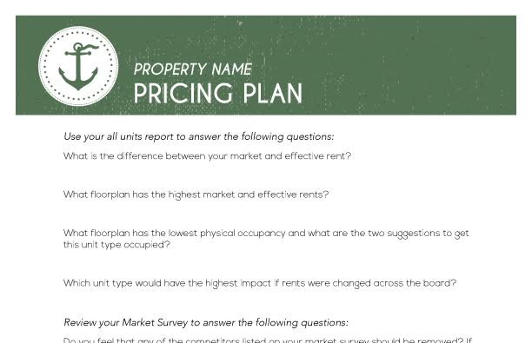
Pricing plan worksheet
Pull out the pricing plan worksheet in your folders
Your folders will contain all the reports needed to complete this activity.
You will turn into pmt once completed.
Time: 20 mins

